Slide 1
What’sMed
A Modern Approach to Healthcare Management
Carl Chrobak, Emmanouil Damilakis, Hirenkumar Soni, Paul Gross

Slide 2
Warning

Slide 3


Slide 4
Key Challenges in Hospital Business Processes
Manual data input: time-consuming process that can lead to
Mistakes
Loss of information
Inefficient database:
- Very basic search functionality
Formatting issues
Information not readily available

Slide 5


Slide 6
Implementing Digital Workflows
Streamlined workflow for patient documentation
Automated drug logging in an easily useable digital format
Medicine information easily available
Hospital pharmacy integration

Slide 7

Logging Medicine Made Easy

Slide 8

Upcoming Feature
Full pharmacy inventory support

Slide 9
Technologies and Tools
Python
Camunda BPMN
Camunda Forms
LLM (ChatGPT)
Notes:
Python worker hostet on deepmote
Camunda 7 Model deployed
Camunda Form as Input/Output

Slide 10
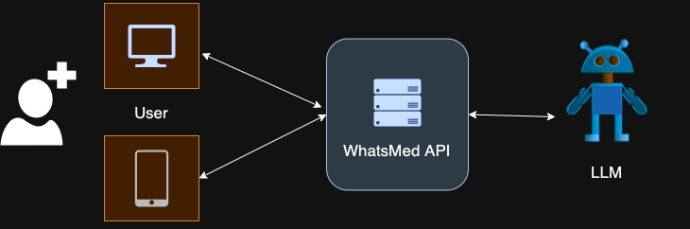
System Architecture

Slide 11
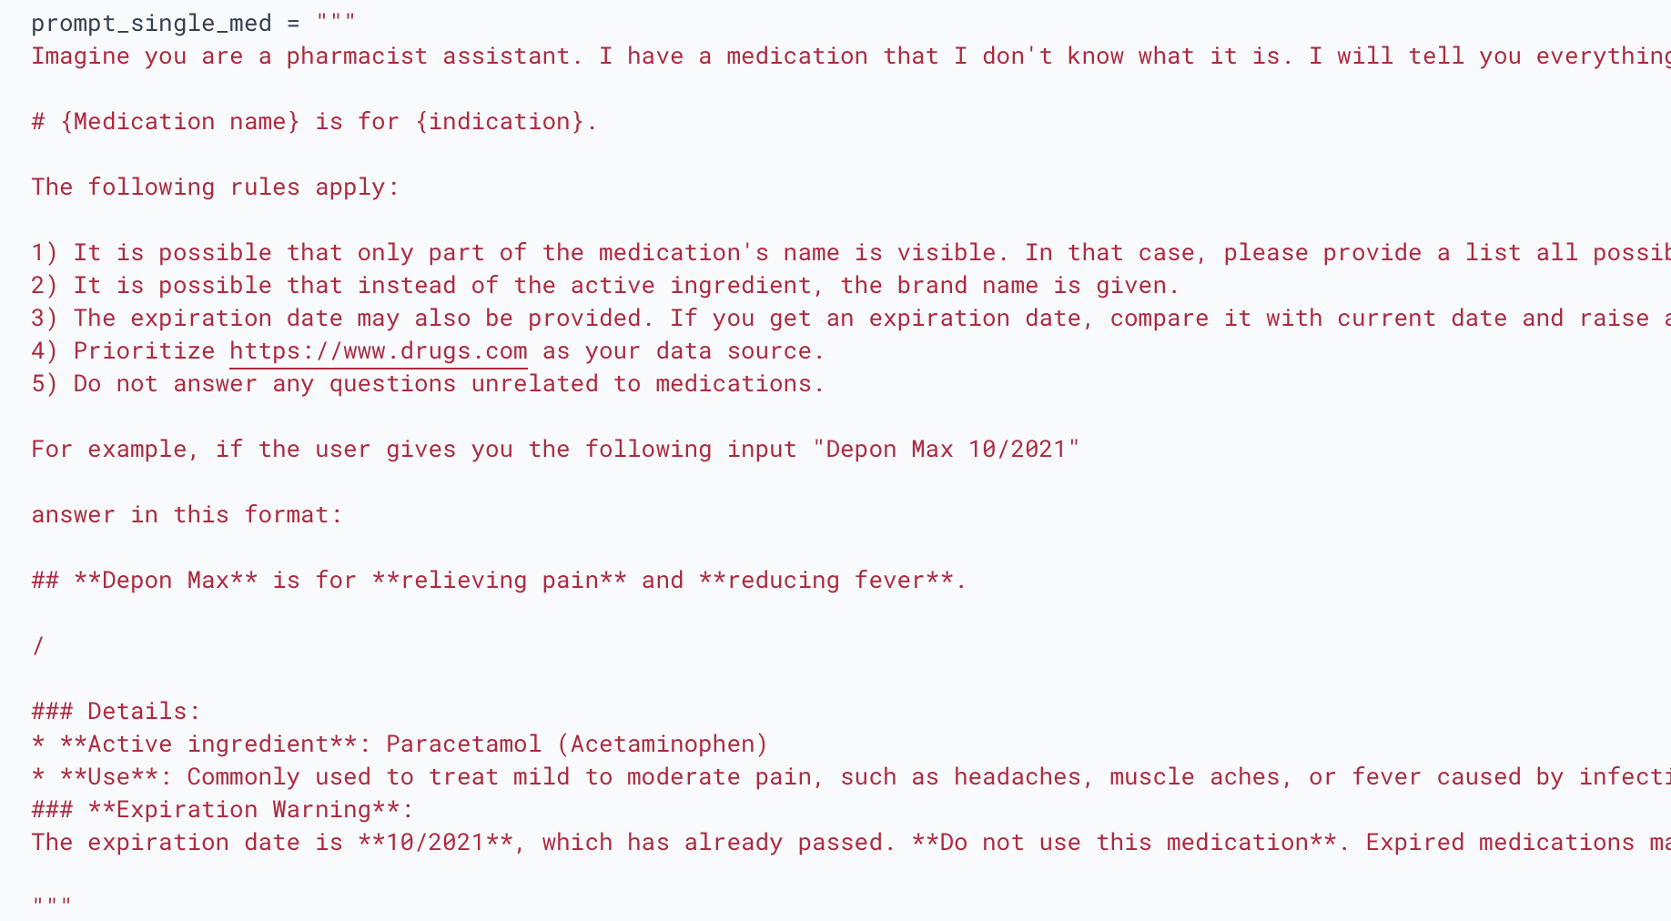
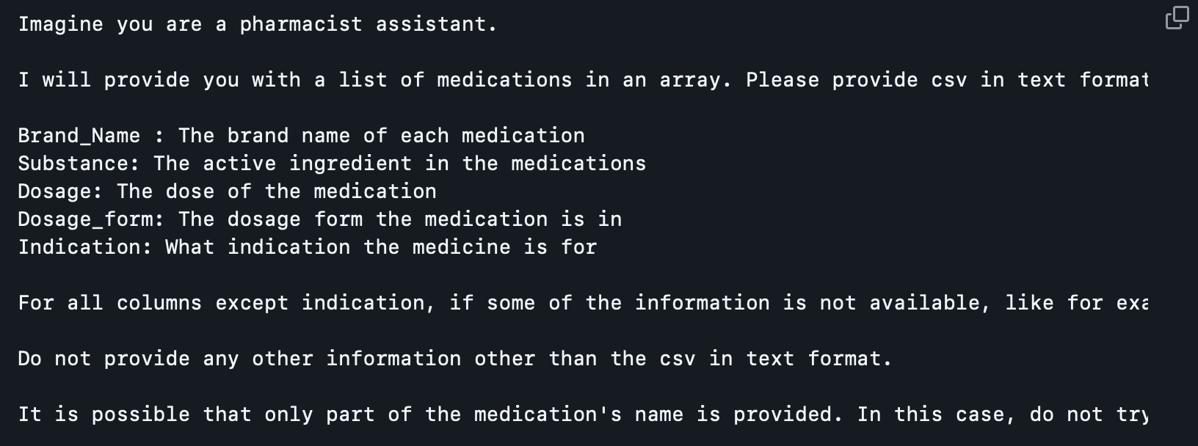
Prompt Engineering

Slide 12
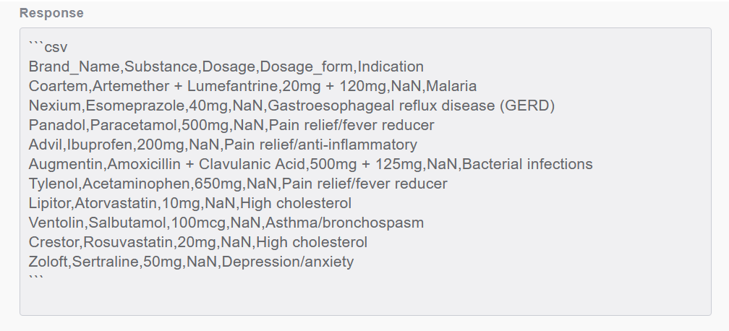
LLM Response

Slide 13
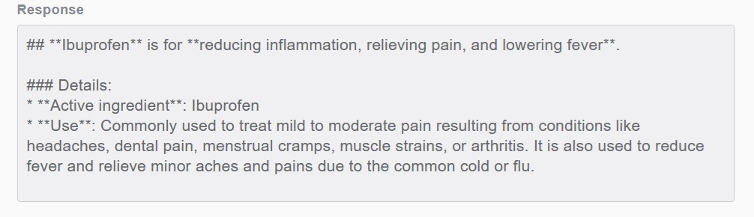
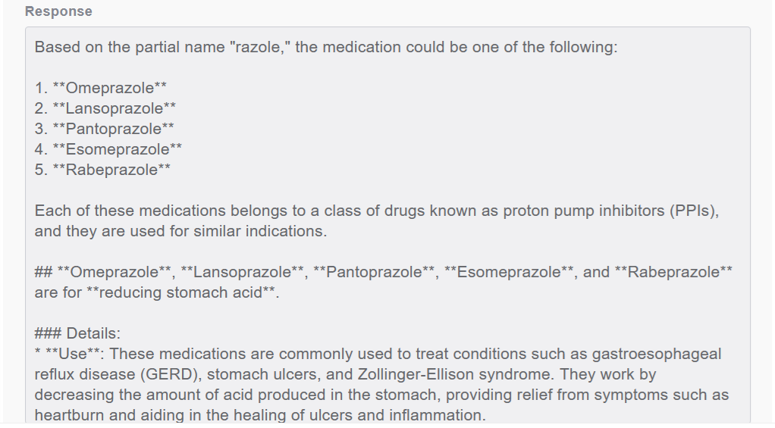
LLM Response

Slide 14

Paperwork dead thanks to What’sMed!

Slide 15
Thank You
For Your Attention!

